Slide 1

Sustainable supply chains and deforestation
The landscape of trade policy initiatives and emerging issues
January 2023

Slide 2

Purpose)
This presentation provides a summary of the trade-related aspects linked to sustainable supply chains and deforestation, developed in the context of the UK GCRF Trade, Development & the Environment Hub project (TRADE Hub).
The aim is to provide an easy-to-access and adaptable resource to experts, academics, decision-makers, IGOs, NGOs etc. working in the field.
Note: the presentation focuses on supply chains associated with deforestation, it does not aim to provide an overview of all trade-related policies linked to forests and sustainable forestry.

Slide 3
Content)
Why is deforestation a global urgency, with the most recent data?
How are trade, sustainable supply chains and deforestation interlinked?
What existing or emerging policy developments and initiative target trade and deforestation?
What are the key questions, opportunities and challenges going forward?

Slide 4

Overview:
what is
the urgency?

Slide 5

Forests are critical for climate
Forest ecosystems are the largest terrestrial carbon storage, accounting for 92% of all terrestrial biomass globally and storing approximately 400 gigatons of carbon.¹
23% of total anthropogenic greenhouse gas emissions (2007-2016) come from agriculture, forestry and other land uses. About 11% of emissions are from deforestation and conversion of natural ecosystems.²
Tropical primary forests, in particular, are critical for carbon storage and biodiversity → loss in 2021 resulted in 2.5 Gt of carbon dioxide emissions, equivalent to the annual fossil fuel emissions of India.³ See slide 6.
Halting deforestation and maintaining forests could avoid emitting 3.6 +/- 2 Gt of carbon dioxide equivalent per year between 2020 and 2050, including about 14% of what is needed up to 2030 to keep planetary warming below 1.5 °C.⁴
Sources: 1) Kayler et al. (2017), 2) IPCC (2019), 3) University of Maryland / Global Forest Watch (2021) and 4) FAO (2022)

Slide 6
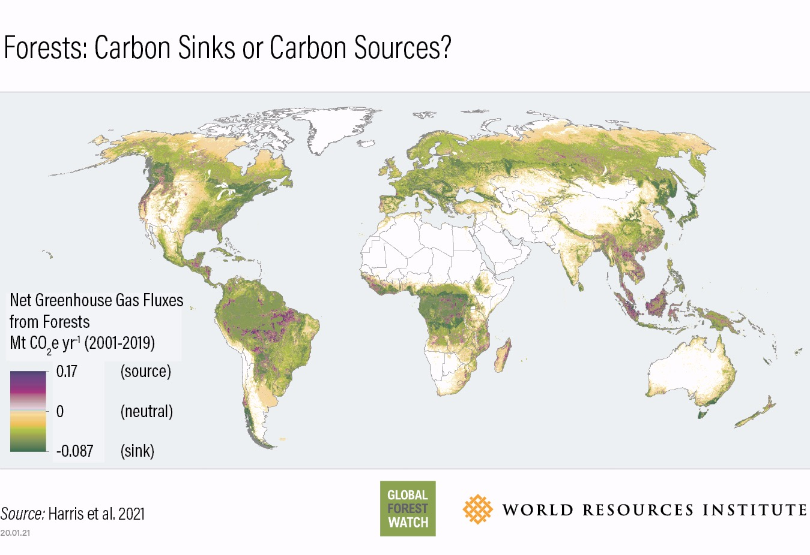
Global Forest Watch (2021)

Slide 7
Deforestation and forest degradation
Deforestation
More than 96% of human-caused, permanent removal of forest cover occurs in the tropics.¹
The tropics lost 11.1 million hectares of tree cover in 2021, with Brazil, DRC, Bolivia and Indonesia among the most affected countries.²
Of the above, 3.75 million hectares (34% of total) occurred within tropical primary forests.² See slide 8.
In recent years, tropical primary forest loss has been in decline only in Indonesia and Malaysia.²
Forest loss in boreal and temperate zones is primarily caused by forestry and wildfires, which are often temporary disturbances to forest cover followed by re-planting or regrowth.¹ These temporary disturbances can, however, lead to the loss of soil carbon.
Forest degradation
In addition to deforestation, forest ecosystems are also fragmenting and degrading (e.g. due to illegal or unsustainable logging).³
Forest degradation often leads to deforestation, especially in the tropics.³
In the tropics, forest degradation accounts for 33% of the observed changes in forest cover in 1990 - 2020.³
Without a reduction of the present disturbance rates, it is estimated that undisturbed forests will disappear in large tropical humid regions by 2050.³
Sources 1) WRI (2022), 2) University of Maryland / Global Forest Watch (2021) and 3) Vancutsen et al. (2021)

Slide 8
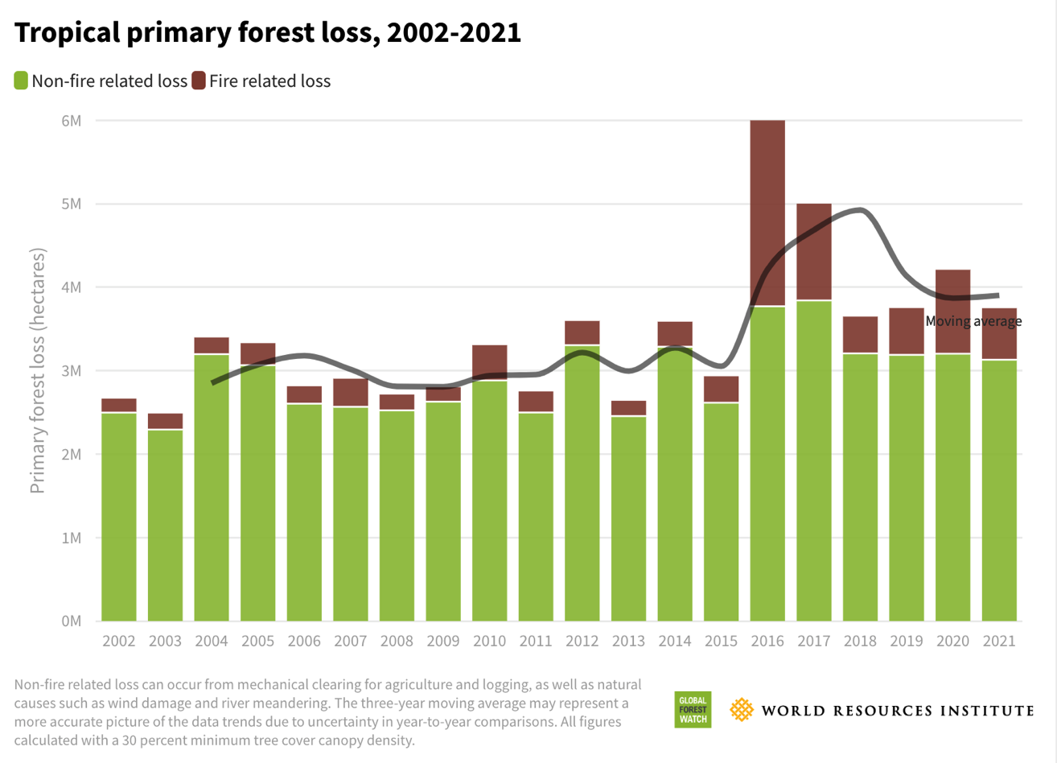

Slide 9
Deforestation impacts livelihoods and wellbeing
About 33 million people are estimated to work directly in the formal and informal forest sector. The sector contributed (directly, indirectly and induced) more than USD 1.52 trillion to world gross domestic product in 2015.¹
In developing countries environmental income accounts for 28% of total household income, 77% of which comes from natural forests.²
Estimated 3.5 – 5.76 billion people use non-timber forest products for own use or to support livelihoods, supporting food security and nutrition of especially in remote areas in the tropics and subtropics.¹
Deforestation and forest fragmentation can increase the risk of viral disease outbreaks.¹
Sources: 1) FAO (2022) and 2) Angelsen et al. (2014)

Slide 10

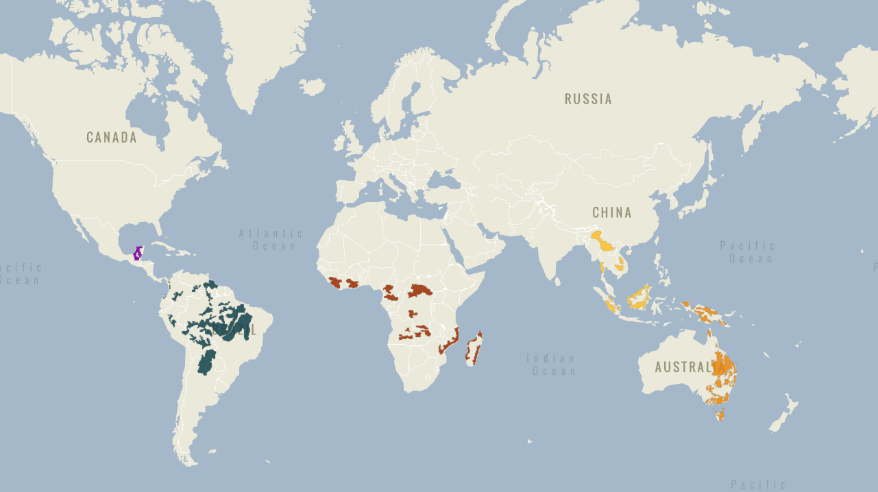
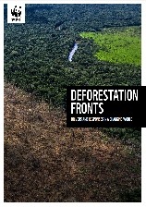
Where is deforestation happening?
“Global Deforestation Fronts”
  24 areas of significantly increasing deforestation during 2004 - 2017
  Total area lost: 43 million ha
  Top 3 areas for loss (ha): Brazilian Amazon, Borneo and Grand Chaco (Paraguay / Argentina)
Source: WWF 2021

Slide 11

The role of trade
in deforestation: opportunities
and challenges

Slide 12

Drivers of deforestation (1/2)
Agricultural expansion drives 88% of global deforestation¹, with the expansion of commercial agriculture and plantations as the largest drivers.² See slide 13.
Urban expansion and infrastructure development ¹, smallholder farming and extractive activities (particularly mining) are also increasingly important.²
Just seven agricultural commodities — cattle, oil palm, soy, cocoa, rubber, coffee and plantation wood fiber — accounted for 26% of global tree cover loss from 2001 to 2015.³
These agricultural commodities replaced 71.9 million hectares of forest during 2001 - 2015, an area of land more than twice the size of Germany.³
In the tropics, most (90 to 99%) deforestation was estimated to be driven by agriculture in 2011-2015. However, only 45 to 65% of this deforested land was converted into productive agricultural land.⁴
Sources: 1) FAO (2021), 2) WWF (2021), 3) University of Maryland / Global Forest Watch 2021, and 4) Pendrill et al. (2022)

Slide 13
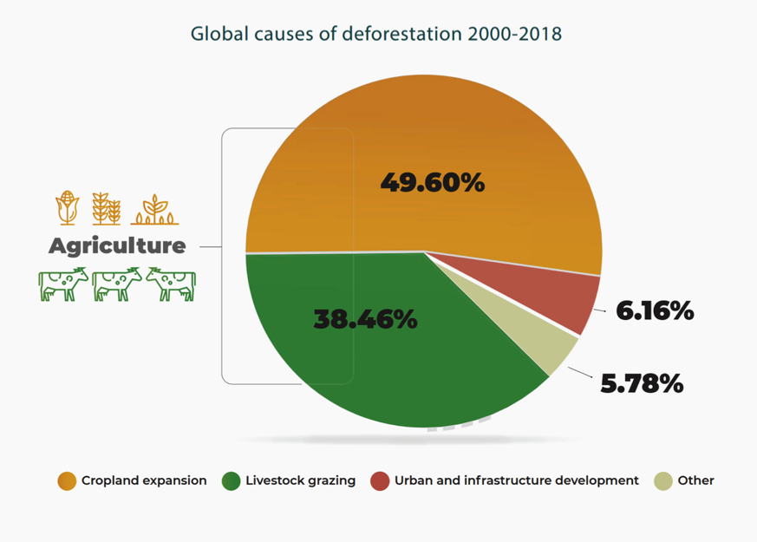
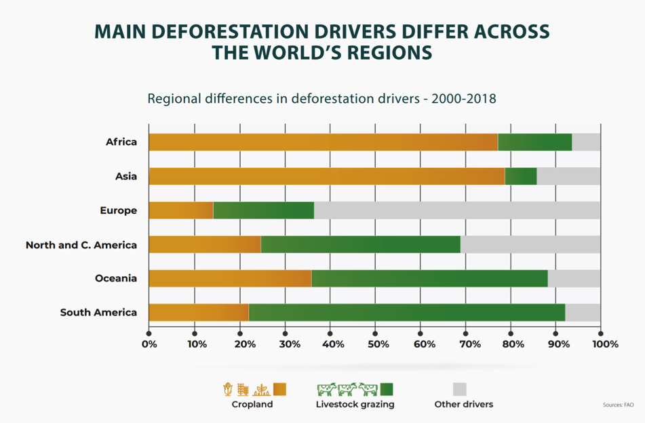
Drivers of deforestation (2/2)
Source: FA0 (2021)

Slide 14
Trade as a driver of deforestation
International trade—spurred by international demand and consumption patterns—plays a role in driving changes in land- and resource use and management associated with biodiversity loss (e.g. deforestation).
Recent studies have estimated:
  More than 50% of the biodiversity loss associated with consumption in developed economies occurs outside their territorial boundaries.¹
  Out of a total of 927 projected extinctions due to current global land use, 25% is due to land use for export production.²
  26% of deforestation can be attributed to international demand, the bulk of which (87%) was exported to Europe and Asia (China, India and Russia).³
  For example, EU consumption during the period 2008-2017 was responsible for 19% of tropical deforestation embedded in the global imports of wood, palm oil, soy, cocoa, coffee and beef.⁴
  Water and land use demand embodied in international soybean trade is mainly driven by demand in China, the Netherlands and Mexico, for soybean grown in the US, Brazil and Argentina. Animal feed is responsible for around three-quarters of this resource use.⁴
  International demand, especially from China, drives more than half of soy’s impacts on endemic Cerrado biodiversity in Brazil.⁵
Sources: 1) Wilting et al. (2017), 2) Chaudhary & Brooks (2019), 3) Pendrill et al. (2019), 4) European Commission (2021) based on data by Pendrill et al. (2020), 5) Taherzadeh & Caro (2019) and 6) Green et al. (2019)

Slide 15
How is trade policy relevant?
Trade polices and trade-related policy instruments can be used to regulate unsustainable and incentivise sustainable trade.
In particular, they can impact agricultural practices, which are key “on the ground” driver for deforestation.
They can:
  Set safeguards to prevent deforestation associated with trade and trade liberalization (e.g. in Regional Trade Agreements)
  Set sustainability requirements for products entering the market (e.g. mandatory standards or supply chain due diligence requirements for business)
  Provide preferential market access for sustainable / deforestation-free products (e.g. preferential tariffs)
  Set bans on certain products directly linked to illegal deforestation (e.g. illegally harvested timber)
  Help to remove non-tariff barriers to trade in deforestation-free products (e.g. regulatory cooperation and harmonising standards between trade partners)
  Provide financial support, training and technical assistance that supports sustainable and deforestation-free trade

Slide 16
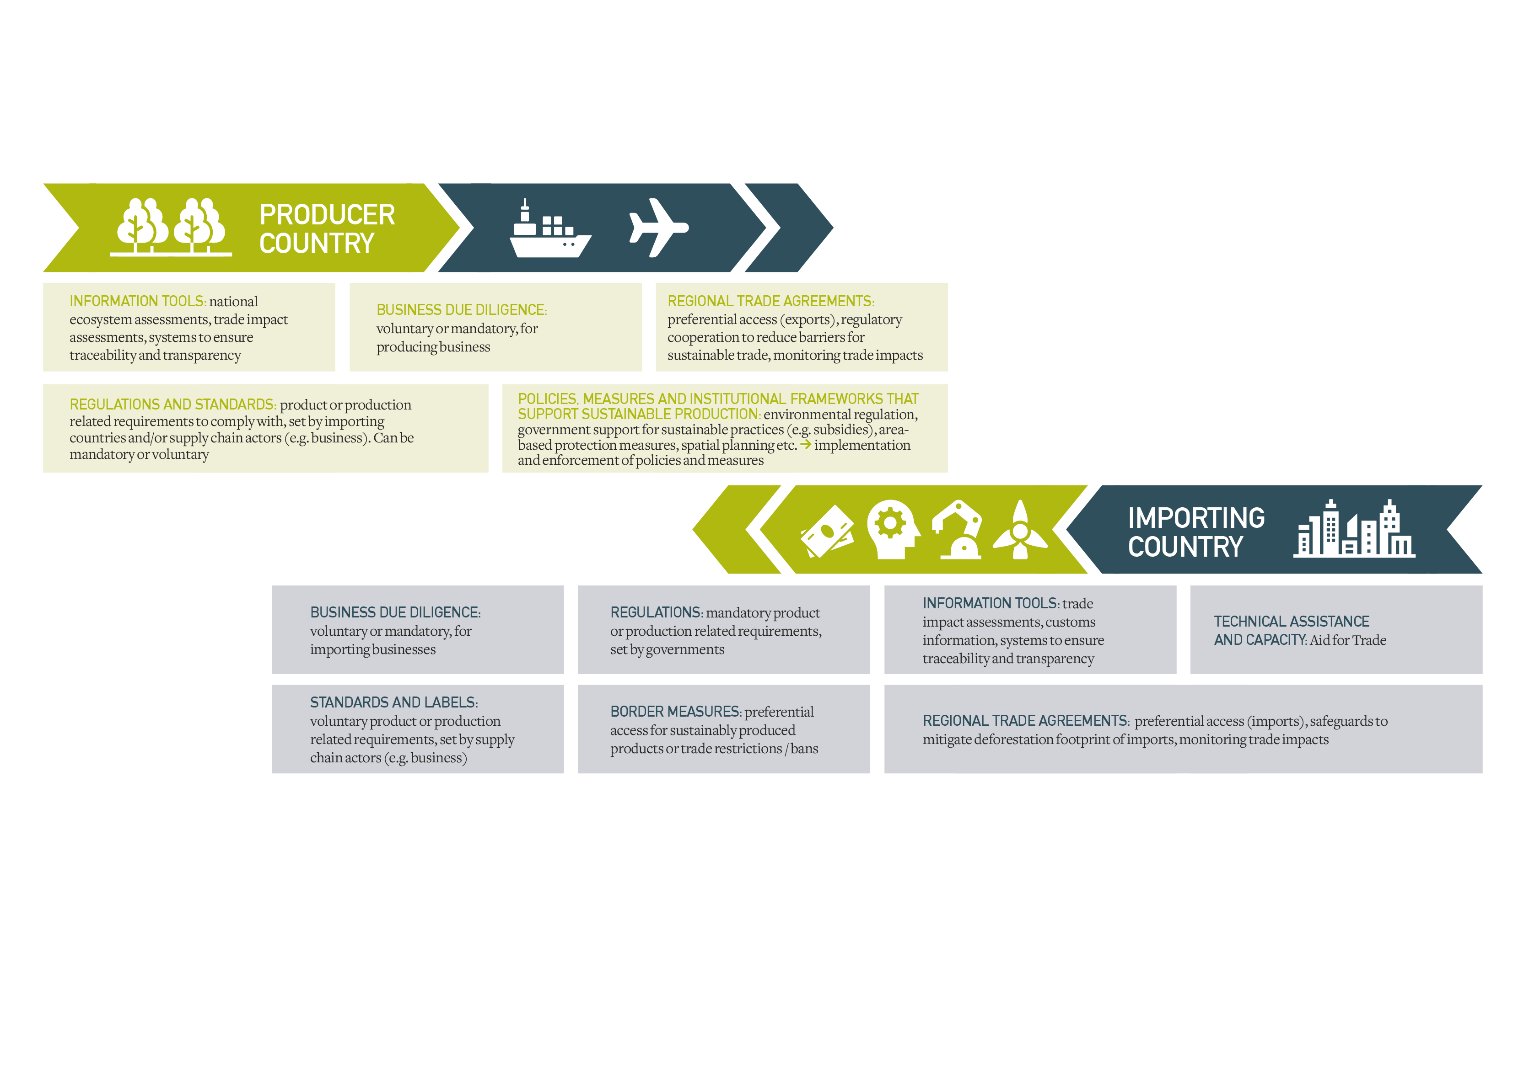
Deforestation-free supply chains: what kind of policies and measures are involved?

Slide 17
What are the opportunities?
Shift to and investment in deforestation-free supply chains can support sustainable trade and related socio-economic opportunities.
National
  Market access, retaining old and gaining new export markets (Examples 1 and 2)
  Diversification of exports
Business
  Market advantage, responding to increased regulation and consumer demand for sustainability (Examples 1 and 2)
  Supply chain stability, with sustainable supply chains being more resilient and adaptable
Producers (e.g. smallholders)
  Access to global supply chains (Examples 1 and 2)
  Reliable and fair prices as part of sustainability standard schemes (e.g. Example 3)
Example 1: Starting from 2018, the government of Gabon made the issuance of forestry permits conditional on Forest Stewardship Council (FSC) certification by 2022, with the goal of increasing forestry exports and their contribution to GDP. The FSC Forest Management certificates covered more than 2 million hectares of forests by December 2019, almost 10% of the total forest area in Gabon. UNFSS (2021)
Example 2: The government of Indonesia introduced the Indonesian Sustainable Palm Oil (ISPO) certification in 2011 as a mandatory requirement for all oil palm growers and millers operating in the country, with the objective of addressing environmental issues in the sector and improving the competitiveness of Indonesian palm oil in the global market. The certification requirements were updated in 2020. The current requirement is that all Indonesian palm oil companies must be ISPO accredited by 2023 meaning all Indonesian oil palm growers, not just those exporting to foreign markets, must conform to higher ISPO certification standards. Henry, D. (2021)
Example 3: Compliance with voluntary sustainability standards can contribute to poverty alleviation in many ways, such as supporting skills training for farmers, that can support better practices, producer knowledge, and capacity to grow higher-quality and more sustainable products. In turn, this can bring farmers higher and more stable prices and crop income, as well as increased social capital via stronger producer organizations. IISD (2021)

Slide 18

Existing and emerging policy developments & initiatives linked to trade and deforestation

Slide 19

Glasgow Leaders’ Declaration on Forests and Land Use (COP26)
Glasgow Leaders’ Declaration on Forests and Land Use, adopted at UNFCCC COP26 in 2021
Endorsed by 145 countries, not legally binding
% of global forest covered by endorsers: 91%
Aim: high level political declaration by countries to work collectively to halt and reverse forest loss and land degradation by 2030 while delivering sustainable development and promoting an inclusive rural transformation. Including, inter alia, facilitating trade and development policies, internationally and domestically, that promote sustainable development, and sustainable commodity production and consumption, that work to countries’ mutual benefit, and that do not drive deforestation and land degradation.
Status: no official monitoring process or accountability framework adopted as part of the Declaration that would allow estimating progress by countries.¹ Followed up by Forest and Climate Leaders’ Partnership (FCLP) at COP27 See slide 20.
Source: 1) GermanWatch (2022)

Slide 20
Forest and Climate Leaders’ Partnership (COP27)
Forest and Climate Leaders’ Partnership (FCLP), launched at UNFCCC COP27 in 2022
Joined by 26 countries¹, not legally binding but has an agreed accountability process (see below)
% of global forest covered by countries joined: 33%
Aim: follow up to the Glasgow Leader’s Declaration aimed at scaling up action to halt and reverse forest loss and land degradation by 2030 while delivering sustainable development and promoting an inclusive rural transformation. Members are committing to play a leadership role to drive forward at least one of the FCLP’s action areas, which are: 1) international collaboration on the sustainable land use economy, 2) mobilising public and donor finance to support implementation, 3)shifting the private finance system, 4) supporting Indigenous Peoples’ and local communities’ initiatives, 5) strengthening and scaling carbon markets for forests, and 6) partnerships and incentives for preserving high-integrity forests.
Status: launched at COP27 in 2022, with an accountability process involving annual meetings and publishing annual Global Progress Reports that include independent assessments of both global progress toward the 2030 goal, and progress made by the FCLP.
Source: UNFCCC 2022 and UK Government (2022)

Slide 21
FACT dialogue
Forest, Agriculture and Commodity Trade (FACT) Dialogue, launched at UNFCCC COP26 in 2021
Co-chaired by UK and Indonesia, not legally binding
Aim: government-to-government dialogue aiming to bring together the largest producers and consumers of internationally traded agricultural commodities (e.g. palm oil, soya, cocoa, beef and timber) to protect forests and other ecosystems, while promoting trade and development.
Roadmap: FACT roadmap for action (2021) identifies key areas of work central to achieving the aim of the dialogue. These include trade and market development, smallholder support, traceability and transparency, and research, development and innovation.
Roadmap supported by Belgium, Brazil, Cameroon, Canada, Colombia, Côte d’Ivoire, Democratic Republic of the Congo, Denmark, the EU, France, Gabon, Germany, Ghana, Indonesia, Italy, Japan, Liberia, Malaysia, Netherlands, Nigeria, Norway, Peru, Republic of the Congo, Republic of Korea, Spain, the UK, the US and Uruguay (27 countries + the EU).
Status: framework and processes for cooperation established in 2022, with 3 to 5 years horizon. See FACT Progress Report 2022 for more details and concrete planned outputs.

Slide 22
World Trade Organisation (WTO)
Deforestation and deforestation-free supply chains are not explicitly addressed by any existing multilateral trade rules or ongoing negotiations.
If interest to WTO members, the issue could however be discussed at, for example:
  WTO Committee on Trade and Environment (CTE)
  CTE provides a forum for WTO members to discuss environmental sustainability concerns related to trade, including deforestation.
  Trade and Environmental Sustainability Structured Discussions (TESSD)
  TESSD is a member-led initiative at the WTO, currently participated by 74 WTO members. Discussions are intended to complement the work of the CTE and other relevant WTO bodies with focus on, among others, common areas of interest, best practices, and challenges and opportunities for sustainable trade.
  TESSD identified several priorities for discussion in its 2022 work programme. Some of these priorities are linked with deforestation, including sustainable supply chains, trade-related climate measures, and subsidies.
For more see UNEP (2021)

Slide 23
Regional trade agreements (RTAs)
Deforestation related provisions can be included in RTAs, including in dedicated chapters on Trade and Sustainable Development (e.g. EU and EFTA ) or Trade and the Environment (e.g. US).
These provisions commonly include commitment to fulfill obligations under multilateral environmental agreements (MEAs), e.g. UN Convention on Biological Diversity (CBD).
Some existing RTAs also include explicit provisions for:
  Promoting sustainable forest management and products, such as US-Peru Trade Promotion Agreement (PTPA) and EU – Vietnam FTA provisions on sustainable forestry and illegal logging
  Promoting trade in sustainable agriculture products, such as EFTA-Indonesia FTA preferential tariff for sustainable palm oil
However, none of the existing RTA address deforestation and deforestation-free supply chains in an explicit or comprehensive manner.

Slide 24
Domestic regulations, targeting international supply chains
Several domestic regulations have been recently adopted or are underway to limit deforestation associated with international supply chains.
These address key globally traded commodities associated with deforestation and aim to ensure the sustainability of supply chains by putting in place requirements for businesses (e.g. due diligence processes)

Slide 25
Example: Indonesia
Indonesian Sustainable Palm Oil (ISPO) certification was adopted in 2011 as a mandatory requirement set by the government.
A moratorium on licenses for oil palm plantations was set by the government in 2018, halting the licensing process for any new plantations until 2022.
Status:
  ISPO certification requirements were updated in 2020, stipulating that all Indonesian palm oil companies must be ISPO accredited by 2023.
  The moratorium on licenses for new plantations ended in September 2022, with next steps under review.
Scope:
  For ISPO, all oil palm growers and millers operating in the country
  For moratorium, all new licenses staring from 2018
Supply chain coverage: oil palm

Slide 26
Example: China
National Forest Law, amended in 2019, forbids any enterprise or individual from handling timber they know to be “illegally or indiscriminately felled”.
Status: In place since 2019
Scope: domestically produced (e.g. exported) timber only, with no clear obligations on importers
Supply chain coverage: timber
How does it work?
  No organization or individual may purchase, process, and transport woods in full awareness of their illegal origins, such as illegal felling or deforestation (Art 65).
  Requires timber operating or processing enterprise to establish a data record of input and output of raw materials and timber products (Art 65).
  Foresees competent authorities to supervise and inspect the implementation of the law, including investigate and punish illegal acts such as destruction of forest resources (Art 66).

Slide 27
Example: EU
Deforestation-free products Regulation stipulates that only deforestation- and forest degradation-free products, produced in accordance with local legislation, are allowed on the EU market
Status: political agreement reached Dec 2022, entry into force summer / autumn 2023
Scope: deforestation and forest degradation (illegal and legal), all EU businesses, both EU production and imports from all EU trade partner countries
Supply chain coverage: soy, cattle, palm oil, timber, rubber, cocoa and coffee, and related products (e.g. beef)
How does it work?
  Mandatory due diligence (DD) rules for EU operators, required to put in place and implement DD systems.
  Cut off date for deforestation-free, i.e. after a cut off date (31 December 2020) all commodities are required to be deforestation-free, even if they comply with legislation of the produce country.
  List of commodities regularly reviewed and updated, taking into account new data such as changing deforestation patterns.
  Strict traceability, i.e. operators will be required to collect geographic coordinates of the land where the commodities they place on the market were produced.
  Benchmarking (or traffic light) system operated by the EU Commission will identify countries as presenting a low, standard or high risk of producing commodities or products that are not deforestation-free or in accordance with the legislation of the producer country.
  Partnerships established to support developing countries that are EU trade partners.
  See slide 30 for more information.

Slide 28
Example: UK
UK Environment Act 2021 prohibits the use of products derived from “forest risk commodity” (FRC) unless relevant local laws in producer countries have been complied with
Status: Act adopted in 2021, FRC implementing provisions and timelines for implementation to be agreed in secondary legislation
Scope: illegal deforestation only, imports from all UK trade partner countries, whole UK supply chain but for large businesses only
Supply chain coverage: beef, cocoa, coffee, leather, maize, palm oil, rubber and soy (TBC)
How does it work?
  Businesses prohibited from using FRCs or products derived from FRCs in UK commercial activities unless relevant local laws in producer countries have been complied with.
  Mandatory due diligence (DD) rules for UK operators, with annual DD reporting and non-compliance subject to fines and other civil sanctions.
  Covers the whole supply chain in the UK (i.e. not only businesses responsible importing to the UK market), however applies to “larger businesses” and their subsidiaries only.
  See slide 30 for more information.

Slide 29
Example: US
US Forest Act prohibits the import of products connected to illegally deforested land (i.e. in violation of law in the producer country) to and establishes roadmaps for countries that need to strengthen environmental regulations
Status: proposal introduce in 2021, discussed at the Senate in 2022, entering into force TBC
Scope: illegal deforestation only, imports from countries without adequate and effective protection against illegal deforestation
Supply chain coverage: palm oil, cattle, soybeans, rubber, wood pulp and cocoa
How does it work?
  Identifying “high risk” countries for illegal deforestation and, for these countries, requiring US importers to comply with due diligence measures to ensure illegal deforestation has not taken place.
  Action plans to be developed for “high risk” countries to support their governance and capacity to address illegal deforestation.
  See slide 30 for more information.

Slide 30
Summary: EU – UK – US
 | EU | UK | US
Overview | Commodities or products in scope cannot be placed on EU markets unless they are deforestation- and forest degradation-free (after 31 December 2020), have been produced in accordance with local legislation, and are covered by a due diligence statement. | Prohibition on using deforestation-linked commodities and their derivatives that have not been produced in accordance with local laws relating to the ownership and/or use of land. No specific cutoff dates currently defined. | Unlawful to import any product made wholly or in part from a commodity in scope that is produced from land that undergoes illegal deforestation after the date of enactment.
Commodities in scope | Soy, cattle, palm oil, timber, rubber, cocoa and coffee, and related products (e.g. beef, furniture, chocolate, charcoal) List of commodities regularly reviewed and updated, taking into account new data such as changing deforestation patterns | Cattle (beef & leather), cocoa, coffee, maize, palm oil, rubber and soy could all be within scope, but TBC with secondary legislation | Products "made wholly or in part from" palm oil, soybeans, cocoa, cattle, rubber, and wood pulp
Businesses in scope | All operators placing in-scope goods on or exporting them from the EU market. However, reduced due diligence requirements and longer compliance periods for MSMEs. | Only large companies, with the turnover threshold to be set in secondary legislation. Will apply to any large companies using in-scope commodities in the UK no matter their supply chain position. Exemptions for companies handling small volumes. | Applicable to all importing companies
Domestic commodity production coverage | Yes; production within EU markets, including for exports, is within scope | Requirement for compliance with local laws suggests domestic commodity production would be in scope | No; applies only to imported material
Due diligence expectations | Establishment of a system to identify and obtain information about commodities, assess risk and mitigate. Operators must make available to competent authorities a due diligence statement confirming that the due diligence was carried out and that there is no or negligible risk of non-compliance. | Requires the establishment of a system to identify and obtain information about commodities, assess risk of non-compliance with local laws and mitigate risk. Exact details to be outlined in secondary legislation. | Importers must take "reasonable care" (an existing principle in US customs law) to assess and mitigate risks that commodities were produced on illegally deforested land. Customs and Border Protection to provide guidance on what constitutes reasonable care.
Risk benchmarking | Yes; countries will be assessed as low-, standard- or high-risk of producing commodities that are deforestation-free. Simplified due diligence processes for low-risk areas, enhanced checks on operators / traders for high-risk regions. Benchmarking at sub-national level also envisaged. | No indication that benchmarking will be used | Yes; default and high risk, with simplified import declaration requirements for default-risk countries
Traceability | Geolocation of plot-level points of production required for sourcing across all risk levels | There is no express provision for traceability beyond the due diligence requirements | Import declaration with point of production for designated commodities from high-risk countries
For more detailed analysis / source: Trase Policy Briefing (2022), with updates to the EU Regulation based on the political agreement (6 Dec 2022)

Slide 31

Key issues going forward: opportunities and challenges

Slide 32

Key issues going forward (1/4)
Ensuring that deforestation-free initiatives reduce deforestation
  Risk of shifting exports from one region to another (e.g. from EU to China), with rate of deforestation remaining the same.
  Risk of shift of production to other ecosystems, with “spillover” degradation.
Ensuring deforestation-free initiatives are fair
  Complying with (new) requirements can become a barrier to access markets, especially for developing countries.
  Especially, concerns over smallholders’ ability to comply with traceability requirements.
  Better understanding and addressing of social impacts associated with complying with deforestation-free policies.
  Support to governments and producers to implement deforestation-free practices and comply with requirements (e.g. technology transfer, investment, financing, technical assistance, training, capacity building, access to information). See slide 35.
  Ensuring policy coherence and synergies
  National initiatives can lead to fragmentation of approaches globally, including difference in how "deforestation" and "deforestation free“ are defined between jurisdictions.
  Policy actions to address deforestation need to be coherent with those aimed at addressing other sustainability challenges (e.g. climate change, soil degradation, pollution, social and economic sustainability etc.).

Slide 33
Key issues going forward (2/4)
Trade rules
  Possible impact on multilateralism, as unilateral approaches can been seen to undermine international cooperation.
  Ongoing discussions whether actions taken based on processes and production methods (PPMs) that leave no trace in the final product (i.e. such as deforestation) lead to discrimination under the WTO rules.
  For example, see information on WTO rules on environmental policies (here) and on environmental labelling schemes (here).
Technical / methodological issues
  Ensuring that the traceability of origin and verification of deforestation-free is feasible, including stakeholders have access to data and technology needed (e.g. resources and know-how).
  Improving the assessment of impacts that trade, trade policies and measures have on ecosystems, including deforestation. For example, see European Commission (2021).

Slide 34
Key issues going forward (3/4)
International framework
  Follow up from the Glasgow Leader’s Declaration from Climate COP26 and Forest and Climate Leaders’ Partnership (FCLP) COP27, especially regards to monitoring commitments made by countries and other stakeholders.
  Progress made under the FACT Dialogue, including concrete outputs and their uptake.
  Deforestation related issues featured at the WTO going forward, including ongoing discussions on measures adopted by WTO members.
  The UN Convention on Biological Diversity (CBD) and the post-2020 global biodiversity framework:
    Integration of trade related aspects into updated national biodiversity strategies and actions plans (NBSAPs), including possible use of trade policies or measures to support the delivery of targets.
    Possible uptake of new, trade-related indicators to monitor progress towards targets, such as ”sustainable and legal trade and commercialization in biodiversity-based products” (Target 5) and “global environmental impacts of consumption” (Target 16)?

Slide 35
Key issues going forward: support to producer countries (4/4)
Recognition of different contexts: there is a need to recognize that countries’ environmental and socio-economic circumstances, legal frameworks, and pathways to sustainable development differ, and to provide flexibility for this (e.g. what is legal / illegal varies between countries).
Limiting multiple requirements: improved cooperation between importing countries and supply chain actors is required, to limit producer countries’ need to comply with several sustainability standards and requirements.
Recognizing existing efforts: new regulatory initiatives to curb deforestation should look to build on existing successful approaches that producer countries have already invested in, including voluntary sustainability standards.
Support: support by supply chain actors and/or importing countries is required for producer countries (e.g. smallholders) to comply with requirements. For example, possibility to use Aid for Trade to support developing countries.
Partnerships: successful outcomes require a smart mix of multi-stakeholder coalitions, joint partnerships, local engagement of all value chain representatives – from farmers and cooperatives to manufacturers, traders and local governments. These could be supported by landscape- and jurisdictional approaches.
Traceability of products: while improving traceability withing supply chains is essential, there is a need to ensure feasibility, capacity and access to technology. For example, the feasibility and outcomes of product-by-product traceability are raising concerns, with a landscape approach presented as a more suitable alternative.
Source: based on insights from ITC Roundtables on Deforestation-free Global Value Chains (2022) and TRADE Hub discussion papers

Slide 36

Thank you.

Slide 37
Resources by GCRF TRADE Hub project
  Please visit TRADE Tools Navigator for resources
  Examples:
  Discussion paper on “Linking local, national and international measures on sustainable trade on agricultural commodities”
  Discussion paper on “Taking responsibility for supply chain impacts”
  Policy paper on “Biodiversity and international trade”
  Policy paper on “Greening international trade”
  Policy brief on UK Environment Act (2022)
  Policy brief on the proposal for EU Regulation for deforestation free products (2022)
  Policy brief on the Proposal for US Forest Act (2022)

Slide 38
References
Angelsen et al. (2014) Environmental Income and Rural Livelihoods: A Global-Comparative Analysis, World Development, 64:S12-S28
Chaudhary & Brooks (2019) National Consumption and Global Trade Impacts on Biodiversity, World Development, 121: 178-187
European Commission (2021) EC Staff Working Document / Impact assessment on minimising the risk of deforestation and forest degradation associated with products placed on the EU market (SWD(2021)326)
Pendrill et al. (2020) Deforestation risk embodied in production and consumption of agricultural and forestry commodities 2005-2017, a dataset
FAO (2021) Briefing on FAO Remote Sensing Survey
FAO (2022) State of the World’s Forests 2022: Forest pathways for green recovery and building inclusive, resilient and sustainable economies
GermanWatch (2022) Factsheet on the Glasgow Leaders’ Declaration on Forests and Land-Use
Global Forest Watch (2021) Forests Absorb Twice as Much Carbon as They Emit Each Year
Green et al. (2019) Linking global drivers of agricultural trade to on-the-ground impacts on biodiversity, PNAS, 116/46: 23202-23208
IPCC (2019) Climate Change and Land: an IPCC special report on climate change, desertification, land degradation, sustainable land management, food security, and greenhouse gas fluxes in terrestrial ecosystems
Kayler et al. (2017) Considering Forest and Grassland Carbon in Land Management, General Technical Report by the US Department of Agriculture, Forest Service
Pendrill et al. (2019) Deforestation displaced: trade in forest-risk commodities and the prospects for a global forest transition, Environmental Research Letters, 14/5
Pendrill et al. (2022) Disentangling the numbers behind agriculture-driven tropical deforestation, Science, 377/6611
Taherzadeh & Caro (2019) Drivers of water and land use embodied in international soybean trade, Journal of Cleaner Production, 223: 83-93
Trase Policy Briefing (2022) UK Environment Act: Use of Forest Risk Commodities in Commercial Activity
UNEP et al. (2021) Biodiversity and international trade policy primer: How does nature fit in the sustainable trade agenda?
UNFCCC (2022) COP27: Leaders Boost Sustainable Forest Management
UK Government (2022) World Leaders Launch Forests and Climate Leaders’ Partnership at COP27
University of Maryland / Global Forest Watch (2021) Forest Pulse: The Latest on the World’s Forests
Vancutsen et al. (2021) Long-term (1990–2019) monitoring of forest cover changes in the humid tropics, Science Advance, 7/10
Wilting et al. (2017) Quantifying Biodiversity Losses Due to Human Consumption: A Global-Scale Footprint Analysis, Environ. Sci. Technol. 51/6: 3298–3306
WRI (2022) Indicators of Forest Extent: Forest Loss
WWF (2021) Deforestation Fronts

Slide 39
UNEP (2022). This briefing has been developed by The Forum on Trade, Environment & the SDGs (TESS) in collaboration with the United Nations Environment Programme (UNEP), in the context of Trade, Development & the Environment Hub (TRADE Hub) project .
We acknowledge funding from the UK Research and Innovation’s Global Challenges Research Fund (UKRI GCRF) through the Trade, Development and the Environment Hub project (project number ES/S008160/1).
The TRADE Hub does not take any responsibility for modifications and updates.
Author: Marianne Kettunen / TESS and TRADE Hub
Contact person: Beatriz Fernandez / UNEP (beatriz.fernandezhernandez@un.org)
Latest update: December 2022
Design © for TRADE Hub by Alan J. Tait

